Slide 1
CS242 Project Part B– Winter 2023
Presented By Shihab Rashid

Slide 2
Agenda
Project Overview
BERT Encoding
FAISS
Query Interface

Slide 3
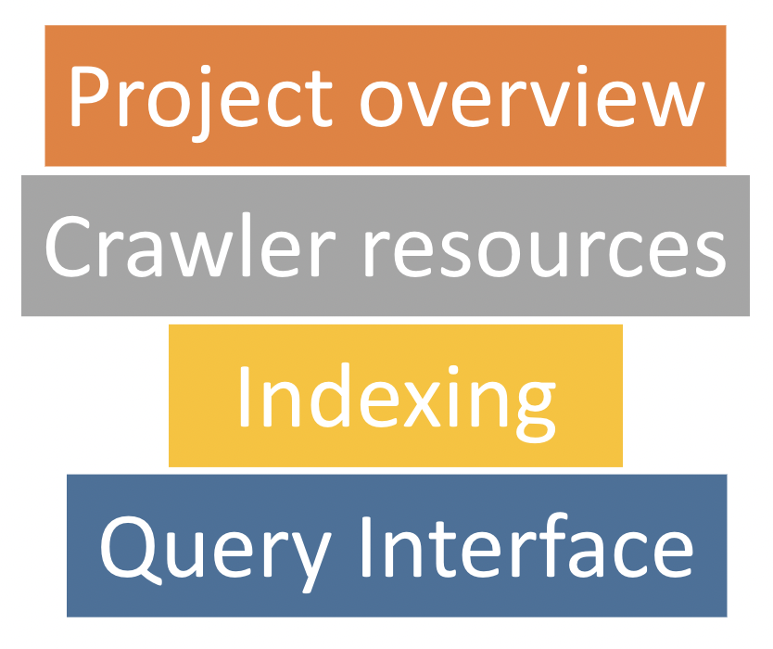
Agenda
Part A
Sparse (using PyLucene or PyElasticSearch)
Dense (using BERT)
Part B

Slide 4
Project Overview – Part B – Mar 17
Generate dense embeddings using BERT
Index and search using the dense embeddings
BERT
Web UI is optional, UI is mandatory
A UI to take input from the user and their index choice, return top-k results
Web UI

Slide 5
Project Overview
Crawled Data
Sparse Indexing
Dense Indexing
UI
Query
Results

Slide 6
Sparse Vs Dense
Sparse: Vector/tensor/array containing mostly zero values
Dense: mostly non-zero values
The quick brown fox jumped.
[0,0,…..,1,0,….1,…0,0…]
[0.123, 0.56, 0.22, 0.56, 0.78, …..]
A sparse one hot encoded vector where 1 means the word is present
A dense vector where each position has “some” information about the sentence

Slide 7
Lucene (Sparse)
Passage 1
Passage 2
The quick brown fox jumped.
The lazy fox slept.
Inverted Index:
The : [P1:1:0, P2:1,0]
quick : [P1:1:1]
brown: [P1:1:2]
fox: [P1:1:3, P2:1:2]
jumped: [P1:1:4]
lazy: [P2:1:1]
slept: [P2:1:3]
Tokenizes
Computes TF-IDF

Slide 8
BERT
Bidirectional Encoder Representation from Transformers
A language model
Only uses encoder part of a transformer
Uses contextual information
Can produce a dense “embedding” of a text

Slide 9
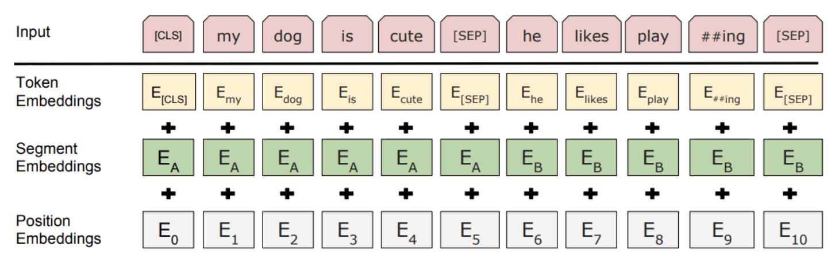
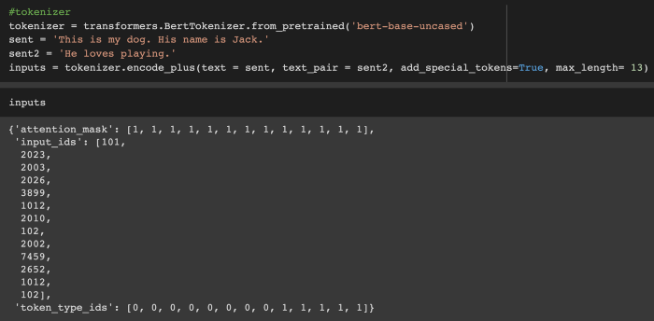
How does BERT produce embedding

Slide 10
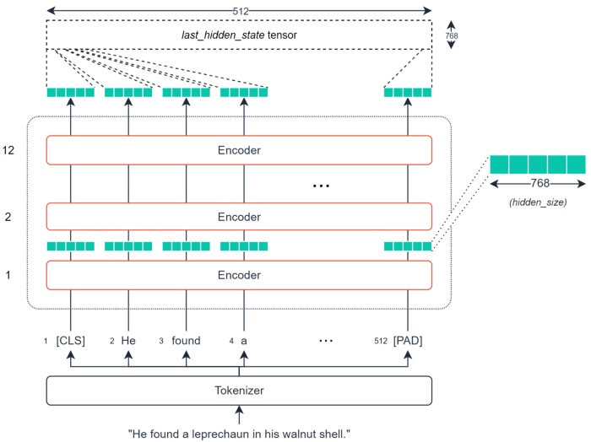
How does BERT produce embedding
BERT takes upto 512 tokens, if less than that it uses padding, if greater it truncates
Using tokenizer it tokenizes the text and creates the “inputs” for the “model”
The model generates tensors for each encoder layer
The output of last_hidden_state is considered as the “embedding” of the text
Text is 512 tokens, embedding dimension is 768 (can change depending on the model)
[512, 768] sized tensor
How do we get an embedding for the whole text?
Need to “transform” every tokens embedding into a single one
Usually done with “Mean Average Pooling”
Pooled tensor is now a representation of the whole text
https://towardsdatascience.com/bert-for-measuring-text-similarity-eec91c6bf9e1

Slide 11
BERT for Text Similarity
BERT can be used for many downstream NLP tasks
For each downstream task a BERT model can be fine-tuned
Lots of such fine-tuned models can be found on Huggingface
Sentence/Paragraph similarity models are fine-tuned on sentence-pair dataset
Given a sentence from the pair, the model should predict which out of a set of randomly sampled other sentences, was actually paired with it in the dataset.

Slide 12
Project Part B and BERT
Given a query(text) return related documents(text)
A text similarity problem
How to measure whether a query is similar to a document?
Use BERT ofcourse
But BERT can only produce embeddings of the query and the document
How to measure the similarity between two embeddings?

Slide 13
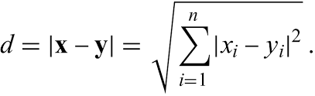
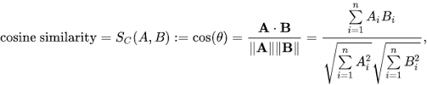
Similarity Between Embeddings
Euclidean Distance
Cosine Similarity

Slide 14
Similarity Between Embeddings
Use a similarity algorithm to compute a score between the query and for all documents
Rank the documents by the score, return top-k
If there are millions of documents?
For each time a user submits a query do we generate embeddings of each document every time?
Very time consuming!
Need to store the embeddings of all the documents in the collection somewhere
A database?
Another index?
A magical library by Facebook that does all the work for you?

Slide 15
FAISS
Facebook’s library for similarity search for very large datasets
Built using C++ but has Python bindings
Built around an index type and “stores” the embeddings of vectors of any dimension in RAM and has “search” functions. Hence its super fast even for billion documents
FAISS offers:
GPU and multithreaded support for index operations
Dimensionality reduction: vectors with large dimensions can be reduced to smaller dimensions using PCA
Batch processing i.e searching for multiple queries at a time

Slide 16
FAISS Indexes
There are many types of indexes that support different search algorithms
IndexFlatL2 : supports L2 distance searching
IndexFlatIP: supports dot product searching
Dot product is basically cosine similarity without normalizing the vectors
“Flat” means they store the vectors without compressing
You can save and load indexes
Read more: https://github.com/facebookresearch/faiss/wiki/Faiss-indexes

Slide 17
Important Thing to Note
BERT can only take upto 512 tokens as input, if your document is bigger than that it will automatically truncate the document
Do we want this?
Generally tweets are safe from this issue as tweets will not exceed 512 tokens
For websites, the textual content of a webpage can be well over 512 tokens
Need to split the website into “passages” of 512 tokens
BERT tokenizer is NOT whitespace tokenizer, so 512 words != 512 tokens
Usually 700 words ~ 1000 tokens
For safety you can create passages of 350 words

Slide 18
Splitting Webpages
Need to ensure you do not split in the middle of a sentence.
Can use a “stride” while splitting
Last sentence of previous passage will be the first sentence of next passage and so on.
Need to map each passage to the webpage
Keep a hashmap where the key will be passage index and value will be the URL of the website
Search results will return PASSAGES not webpages, need to also show the webpage link of that passage

Slide 19
Part B Summary
Generate embeddings of all passages/tweets and store them as vectors in FAISS
Generate query embedding
Search using the query embedding and return Top-k passages/tweets

Slide 20
UI
For basic UI, terminal is okay.
A single python file when run will ask the user:
The query
Which index to search: sparse or dense
How many search results to return (k)
Will return top search results in the terminal screen. Minimum requirements:
Will show the actual text of the passage/text
Show the URL of the tweet/webpage/reddit post
Will output the score: either the lucene score or FAISS similarity score

Slide 21
WEB UI (Extra Credit)
Need a backend service to create APIs
Django or Flask
Need a simple Front end: A textbox and two radio buttons
Will take user query from textbox and pass it to backend API which will:
Search the appropriate index
Return the results in a JSON format
Front end will display the Results

Slide 22
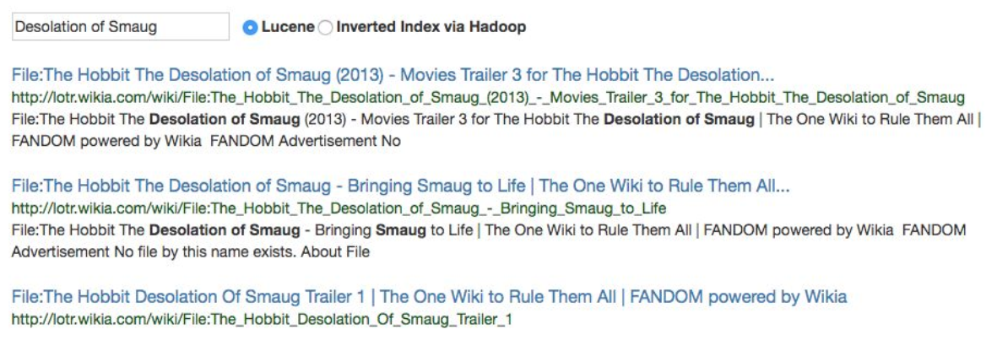
WEB UI (Extra Credit)

Slide 23
Report
Need to compare the index creation time of pylucene and bert and report the time it took
Can also show search time
Need to compare outputs from two indexes given the same query, include your discussion, reasoning about which one performs better and why
Need to include screenshots of running system in report and need to show a running demo on the project presentation
Many more things to include, please see project file

Slide 24
Questions?

